Slide 1
MA 4790/5790-Predictive Modelling FIFA 2017
Joshua Marshall
Raghavendran Shankar
Nishanth Gandhidoss

Slide 2
Objective
About the Data
Goal of Study
Data pre-processing
Data Splitting & Resampling
Questions and comments

Slide 3
About the data
Player attributes sourced from FIFA 2017 – EA Sports game
Scraped from https://www.fifaindex.com/
17K+ player from all around the globe
50+ Player attributes
17588 Observations | 53 Variables

Slide 4
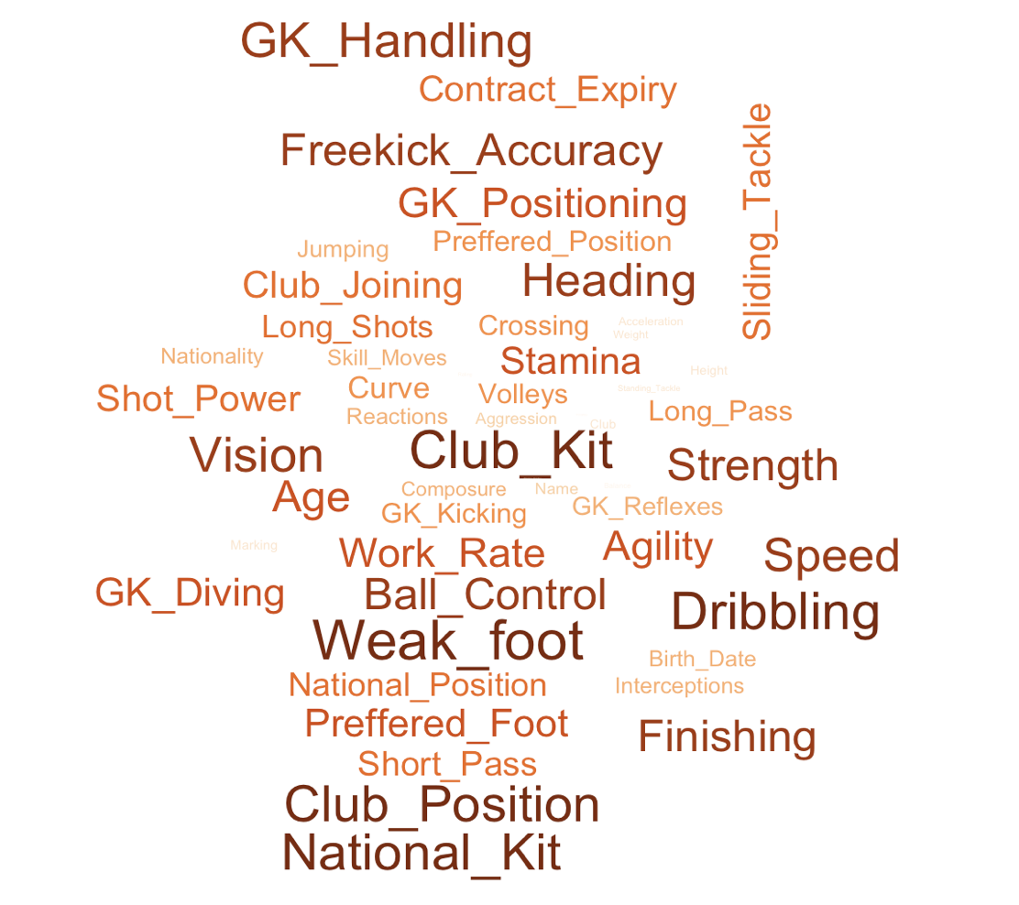
Variables

Slide 5
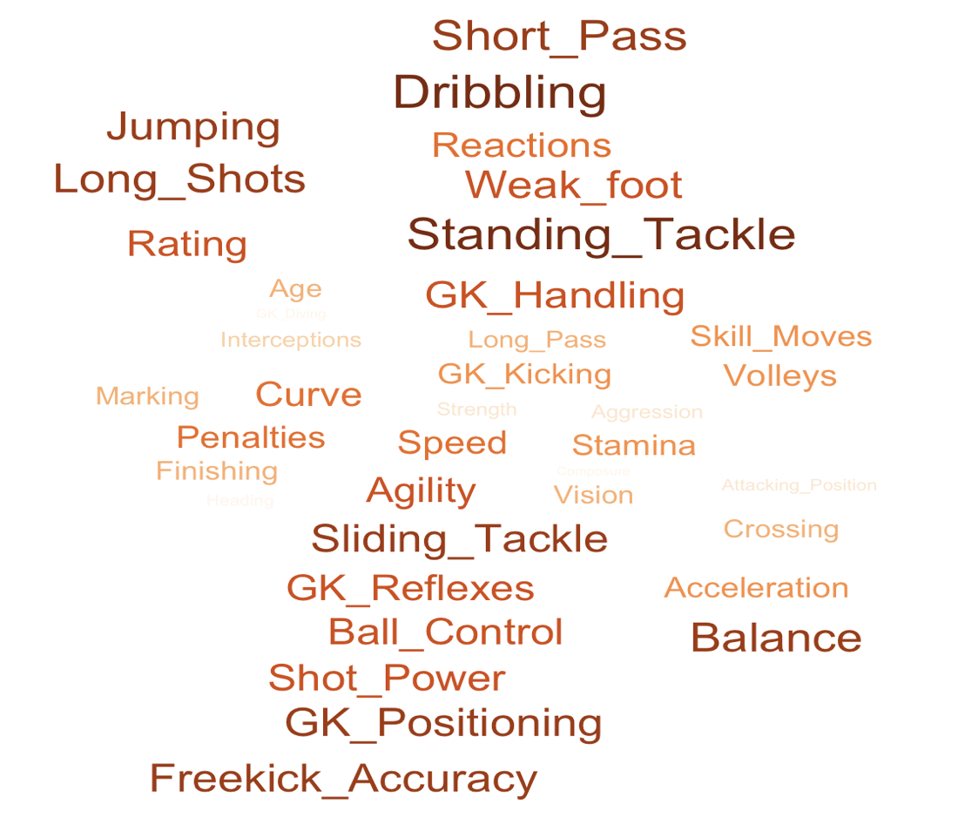
Continuous Variables

Slide 6

Categorical Variables

Slide 7
Goal of Study
Predicting the Player’s rating - Regression
Player’s club field position - Classification

Slide 8

Data Pre-processing

Slide 9
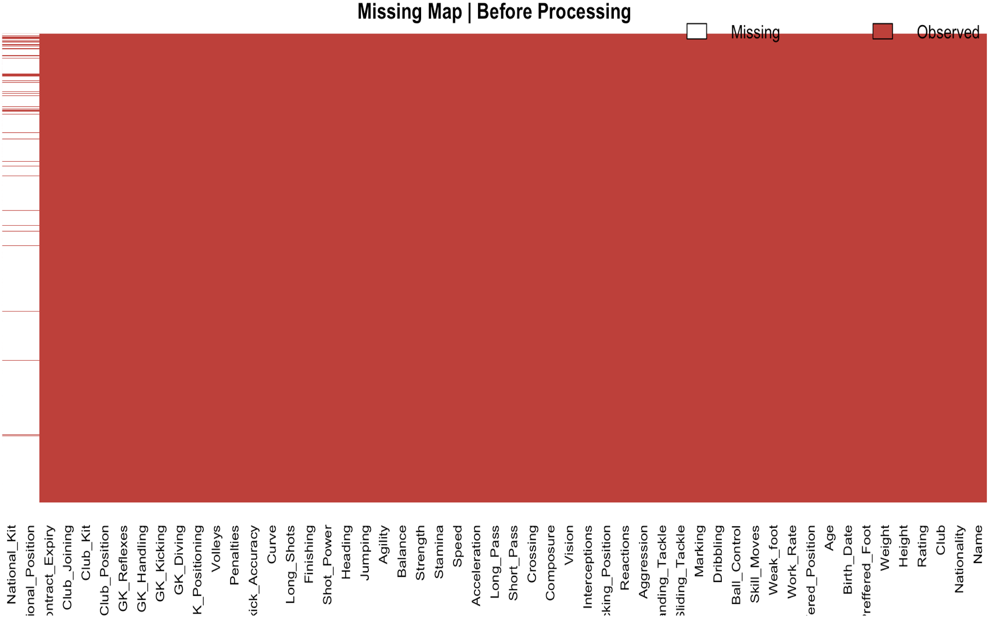
Missing values
Variable | Count
National Position | 16513
National Kit | 16513
Club Position | 1
Club Kit | 1
Club Joining | 1
Contract Expiry | 1

Slide 10
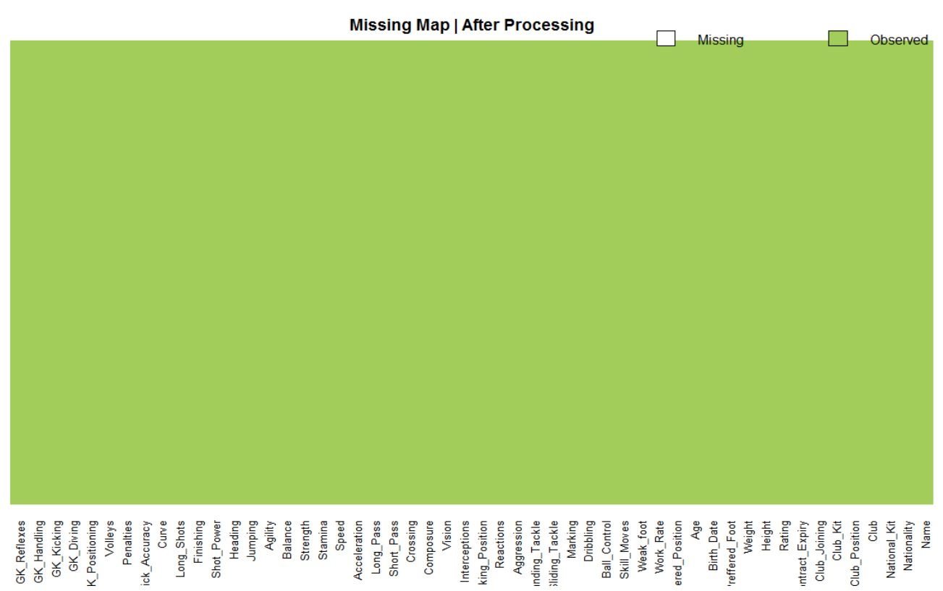
Missing values

Slide 11
Skewness

Slide 12
Skewness

Slide 13
Near zero variance

Slide 14
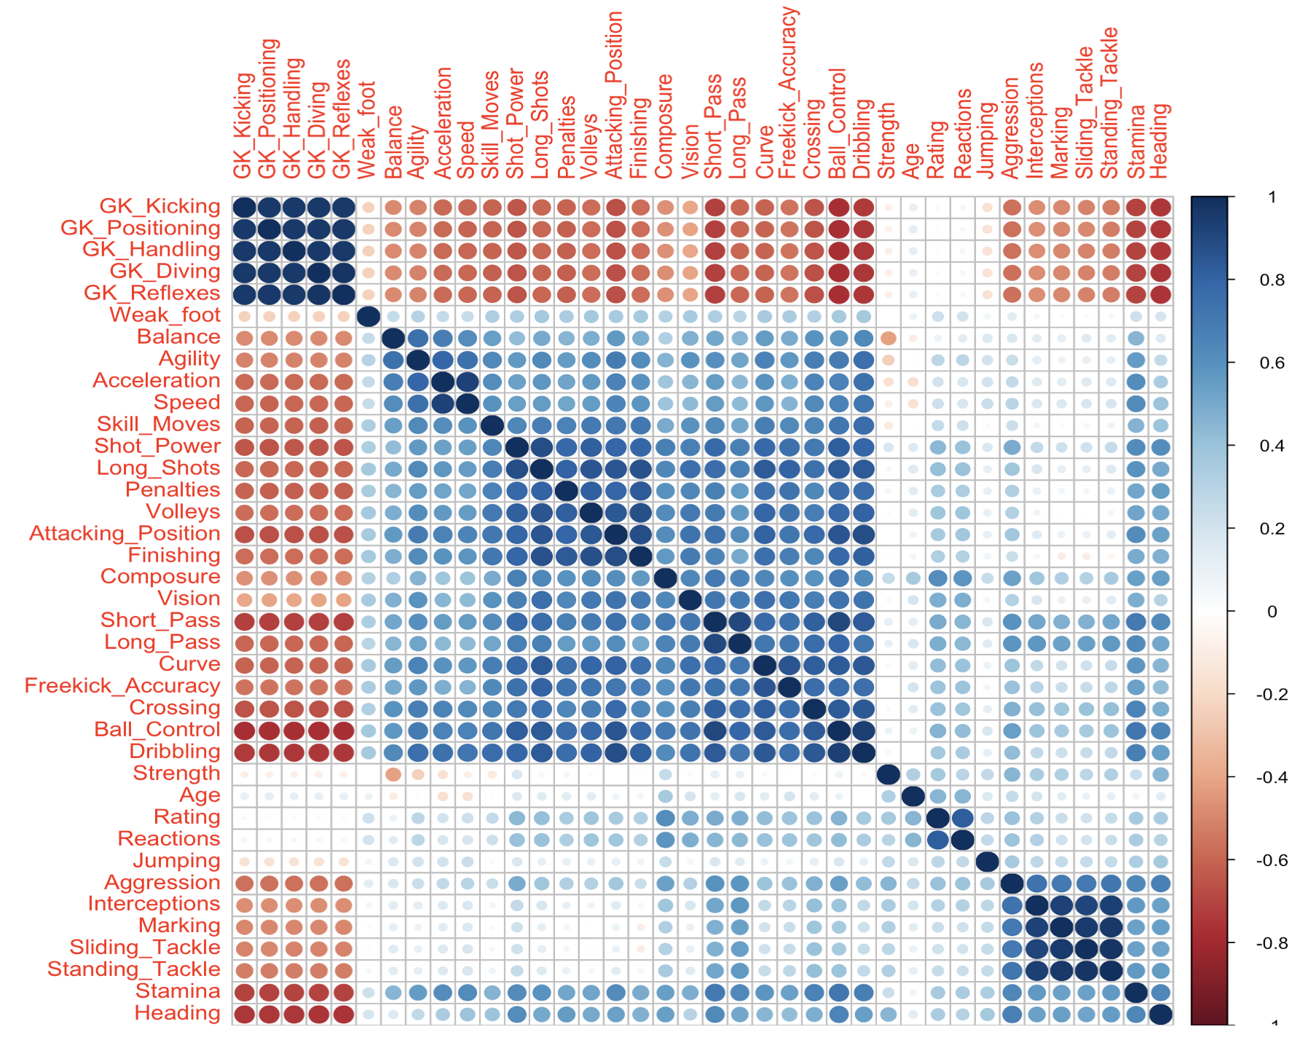
Correlation

Slide 15
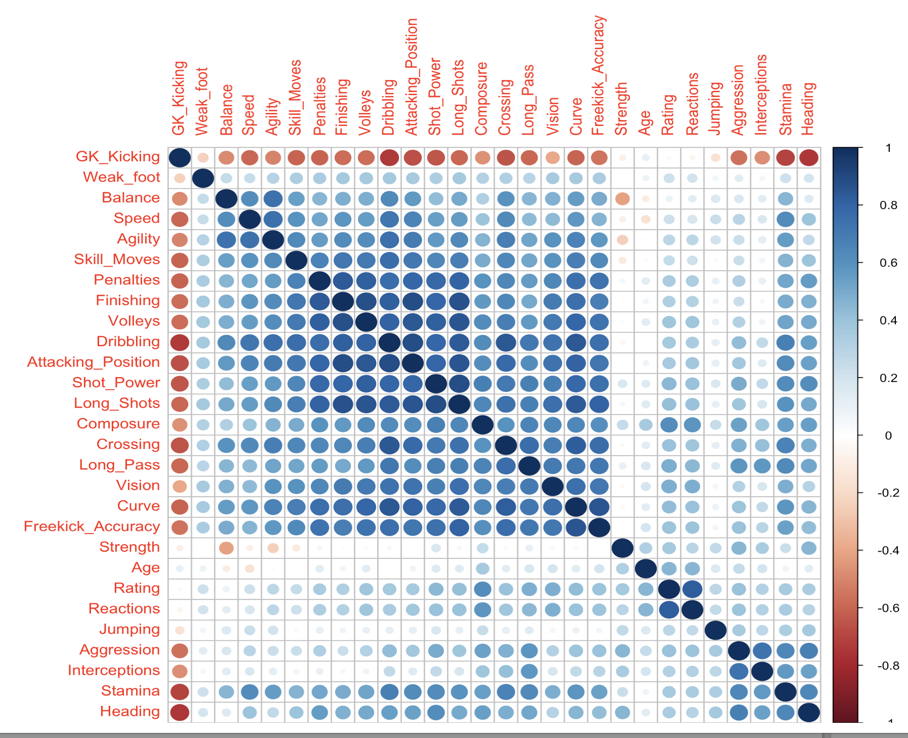
Correlation
Removed Predictors Cut off = 0.9
Ball_Control
Short_Pass
GK_Diving
GK_Reflexes
GK_Handling
GK_Positioning
Acceleration
Standing_Tackle
Sliding_Tackle
Marking

Slide 16
Data Splitting/Resampling

Slide 19

Comments and Questions

Slide 20
Thank You

